Slide 1
How to Navigate Changes to Behavioral Healthcare Landscape
November, 2025

Slide 2
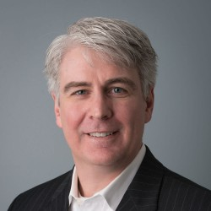
Jeff Capobianco, PhD
Senior Advisor
National Council for Mental Wellbeing

Slide 3
Hello!
When you saw the discussion title
what did you hope I’d speak to?
What is front of mind for you?
Notes:
Pablo Picasso' "Art is the elimination of the unnecessary“
Albert Einstein: "Everything should be made as simple as possible, but not simpler."

Slide 4
Discussion Topics
Is Complexity Manageable?
The Strange Business of SafetyNet Behavioral Health Care
Common Change Models
Discussion

Slide 5
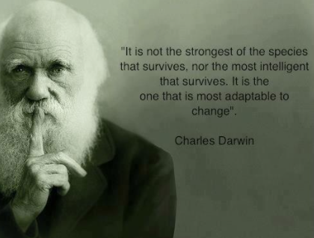

Slide 6


Complicated…

Slide 7
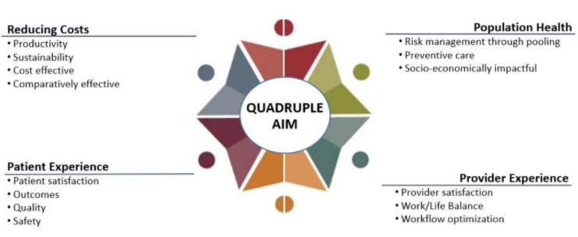
…Complex
Source: From triple to quadruple aim: care of the patient requires care of the provider. Bodenheimer T, Sinsky C. Ann Fam Med. 2014 Nov-Dec;12(6):573-6. doi: 10.1370/afm.1713.
Notes:
Fred Brooks 1986 wrote about no“No Silver Bullett” Turing Award Winner
Accidental Complexities: The unnecessary complexity that is introduced by the solution and can be reduced or eliminated through consistent improvemeents
Essential Complexities: The inherent difficulty in a problem that cannot be removed, no matter how perfect the solution is.

Slide 8









…Complex
Crisis
Services
Person-centered
and Family-centered Treatment Planning
Outpatient Mental
Health and Substance Use Services
Primary Care Screening and Monitoring
Targeted Case Management Services
Psychiatric Rehabilitation Services
Peer
Supports
and Family/
Caregiver Supports
Community Care for Uniformed Service Members and Veterans
CCBHC
Screening, Assessment and Diagnosis
Services may be delivered directly by the CCBHC or by a Designated Collaborating Organization (DCO). CCBHCs are expected to directly deliver the majority of encounters.
Notes:
Crisis Services – Managed by BH ASO
BH ASO Contracts with Providers
Providers are part of the ICN – They’re paid through the MCO>>ASO
What Psych Rehabs Are?

Slide 9
Accidental vs Essential Complexity
“The ability to simplify means to eliminate the unnecessary so that the necessary can speak.”
-Hans Hofmann
Notes:
Pablo Picasso' "Art is the elimination of the unnecessary“
Albert Einstein: "Everything should be made as simple as possible, but not simpler."

Slide 10
The SafetyNet
“Public assistance will be envisaged as a safety net on the one hand, and as a transmission belt to productive employment on the other.”
Franklin Delano Roosevelt Jr. (1966)
“All those with true need can rest assured that the social safety net of programs they depend on are exempt from any cuts. But government will not continue to subsidize individuals or business interests where real need cannot be demonstrated.”
Ronald Reagan (1981)

Slide 11
The Behavioral Health Care Specific Safety Net Challenges
Provider of last resort for the most complex citizens
Highly regulated
Services array requires wraparound social health needs and medical services
Mandated open-door policy
Thin to negative margins without the ability to cost shift
Frequent federal and State funding shifts
Complex funding designs and use of grants to maintain services
Competition for workers
Confusion and stigma related to value proposition

Slide 12
The Behavioral Health Care Specific Safety Net
Opportunities
Uniquely capable of client engagement and whole person care
Organizational values and mission matter
Dedicated workforce
Promotable value proposition
Community Engagement
Expertise in advocacy
Expertise in cost containment
Expertise in federal and state policy forecasting and implementation

Slide 13
Culture & Norms
Culture is the broad, overarching system of mental models, values, and group norms that the group understands to be “normal”.
Norms are the specific, unwritten rules or expectations for behavior within that culture.

Slide 14

Organizations are made up of people and people are made of this…
Behaviors are how these internalized systems (principles, beliefs & values) are expressed with or without integrity (e.g., routine client engagement to improve services).
Principles are the guidelines we use to live our values (e.g., client’s voice will be sought out and honored).
Mental Models are assumptions and convictions we hold to be true based on past experiences (e.g., clients know what they need).
Values are abstract conceptions of what is important and worthwhile (e.g., person centered care). It’s what we care about!

Slide 15
Adaptive Organizations
Change Leadership
“Why & the What”
Change Management
“The How”
Expertise in Change Management
Lives the Vision, Mission & Values
Infinite Game Mindset (Carse)
Relentless Communicator
Team #1 Focus (Lencioni)
Defines & Measures Value
Principles, Policies & Protocols driving Behaviors
Coaching, Managing & Training
Continuous Quality Improvement (CQI)
Team Based Work
Measurement Informed Care Pathways
Notes:
Ada[tove Leadership
The Transformational Leadership Theory was developed by James MacGregor Burns and has since become popular amongst politicians and organizational psychologists.
This theory suggests that leaders can enhance employees’ motivation, morale, and performance by connecting their sense of identity to the company’s mission. Change leaders who employ this style of leadership aim to cultivate enthusiasm and curate a strong sense of purpose throughout the company. They can do so by emphasizing their company’s mission, encouraging their employees to take pride in their work, and evaluating employees’ strengths and weaknesses to optimize their performance.

Slide 16
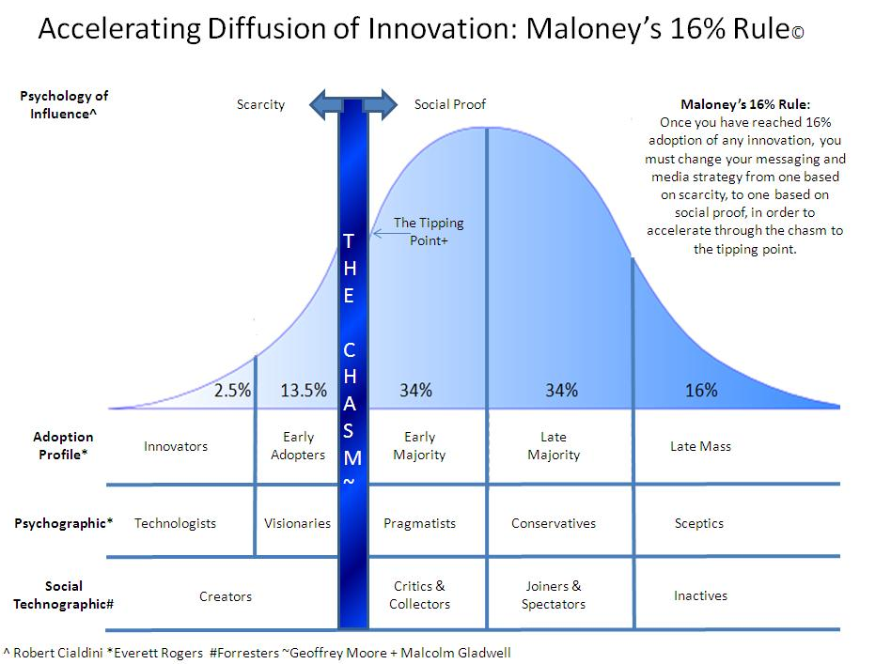
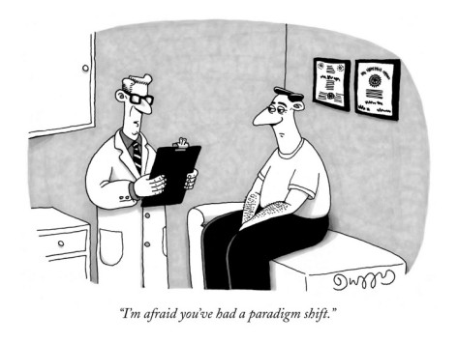

CCBHC = Paradigm Shift
CCBHC

Slide 17

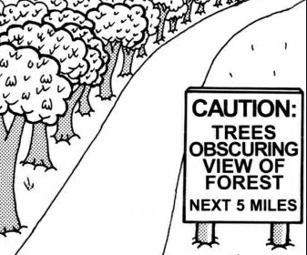
CCBHC
Communicating for Buy-in
Champions
Hesitant
Confused

Slide 18
Stakeholders Need to Know…
Orientation Questions
Implementation Questions
Why are we doing ___________?
Why the urgency?
Why am I involved?
How will it affect me?
What will it look like when we achieve ___________?
How are we going to do this given ___________?
What do I need to do that is new or different?
What do I keep doing the same way?
What do I have to stop doing?
What resources do I have?
Who is going to help me when it gets confusing/frustrating?
What is the timeline?

Slide 19
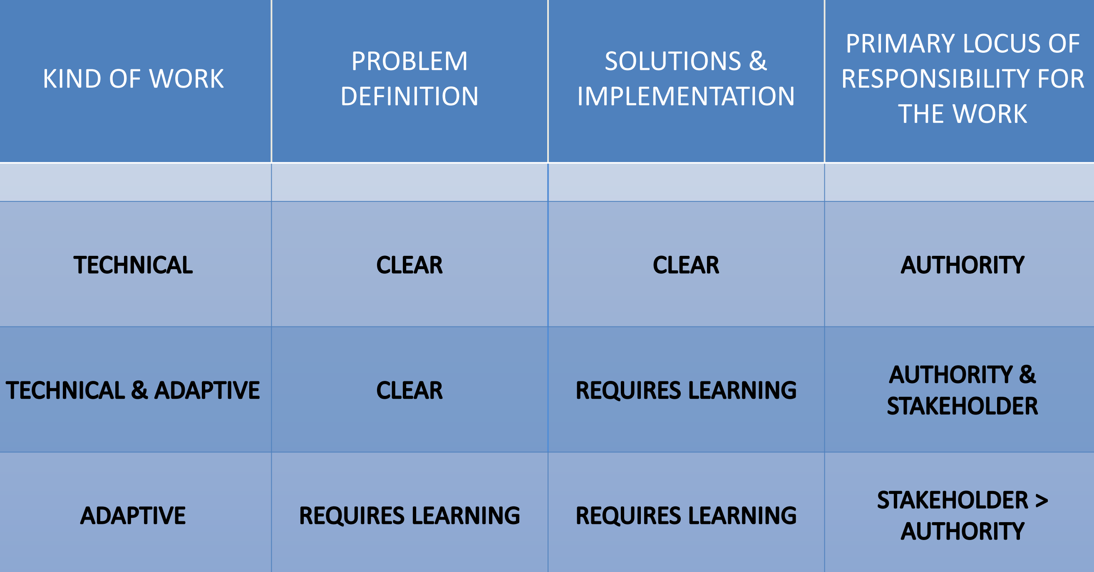

Slide 20
Common Change Models
Author/Model | Primary Focus | Key Mechanism/Stages
Prosci (ADKAR) | Comprehensive Organizational Training | Awareness, Desire, Knowledge, Ability, Reinforcement.
Kotter (8-Step) | Accelerated Organizational Change | Establish Urgency, Guiding Coalition, Vision, Communicate Vision, Empower Action, Short-Term Wins, Sustain Acceleration, Institute Change.
Heifetz (Adaptive Leadership) | Leadership Techniques for Culture & Behavioral Change | Distinguish between Technical (solvable) and Adaptive (behavioral/cultural) challenges; Give the work back to the people.
The Table Group (The Advantage & 5 Dysfunctions) | Organizational Health/Team Effectiveness | Absence of Trust Fear of Conflict Lack of Commitment Avoidance of Accountability Inattention to Results.
Senge (The Fifth Discipline) | Organizational Learning | Building a "Learning Organization" through Personal Mastery, Shared Vision, Mental Models, Team Learning, and Systems Thinking.

Slide 21

When Leading Change…Every Step Matters
+
Guiding Team & Vision
+
Capacity for Change
+
Short Term Win
=
Slow start succumbs to Inertia
Urgency for Change
+
+
Capacity for Change
+
Short Term Win
=
A fast start that fizzles
Urgency for Change
+
Guiding Team & Vision
+
+
Short Term Win
=
Anxiety and Frustration
Urgency for Change
+
Guiding Team & Vision
+
Capacity for Change
+
=
Haphazard efforts and false starts
G-20
Notes:
20

Slide 22
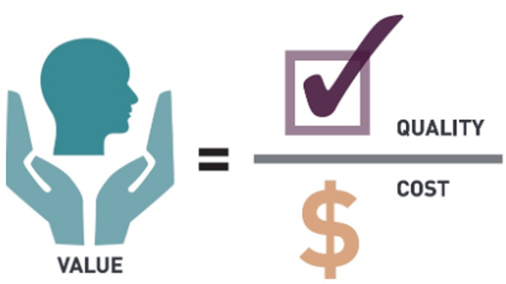
Change Effort Focus Areas
Integrated Team-based Care (ITBC)
Measurement Informed Care Pathways

Slide 23
Principles of Effective Interdisciplinary Teams
Culture of established, open, safe communication patterns.
Well-defined and appropriate team goals.
Clear role definitions and expectations for team members.
Real-time, structured, yet flexible, decision-making process.
Ability of the team to “treat itself” by celebrating accomplishments and addresses breakdowns.
Leverage client input to improve engagement & services design.
Increased Psychological Safety Can Lead to:
27% reduction in turnover
40% reduction in safety incidents
12% increase in productivity
Source: Gallop 2017
Sources: Leipzig, Hyer et al. (2002). Attitudes Toward Working on Interdisciplinary Healthcare Teams: A Comparison by Discipline J Am Geriatr Soc 50:1141–1148.
How to Create a Culture of Psychological Safety, Gallop Jake Herway, Dec 7, 2017 see: https://www.gallup.com/workplace/236198/create-culture-psychological-safety.aspx
Notes:
(Jeff) focusing on teams specifically, research has show that team that design their work through these principles are better able to remain efficient and effective including maintaining staff wellbeing.
Reminder to do poll on this slide: Poll about what elements your agency currently engaged in? 0% (Not started) 25% (just starting) 50% (in progress) 75% (almost done) 100%(Completed)
Speaker note:
Could we have a talking point from Jeff that, big picture, this is about actively creating team culture with shared norms and behaviors related to both operational and relational dynamics…. consider how to share a high level message they can anchor to with these principles as highlights for that.
Also, how to clearly show FIT cross-over.
"Psychological safety is a shared belief that it is safe for interpersonal risk taking. It can be defined as "being able to show one's self without fear of negative consequences of self-image, status or career" (Kahn 1990, p. 708)
In psychologically safe situations, people feel accepted and respected. Results from a number of empirical studies conducted in various regions and countries show that psychological safety plays an important role in workplace effectiveness (Edmondson and Lei, 2014).
It has been consistently playing an important role by facilitating ideas and activities to a shared enterprise. It also enables teams and organizations to learn and perform and in the recent years, it has become a more significant organizational phenomenon due to increased necessity of learning and innovation."
Questions Edmonson found that help teams better engage with each other and create PS include:
What can we count on each other for?
What is our team's purpose?
What is the reputation we aspire to have?
What do we need to do differently to achieve that reputation and fulfill our purpose?

Slide 24


Implementing ITBC
Creating ITBC Buy-in from Stakeholders
Assessing Organizational Infrastructure
Designing the Interdisciplinary Team Structure
Designing the Interdisciplinary Team Processes
Establishing Go-live Process
Sustaining

Slide 25

Measurement Informed Care Pathways
Care Pathways describe how a person moves through services and the protocols describing team processes and related outcomes for both clinical and administrative workflow behaviors.

Slide 26
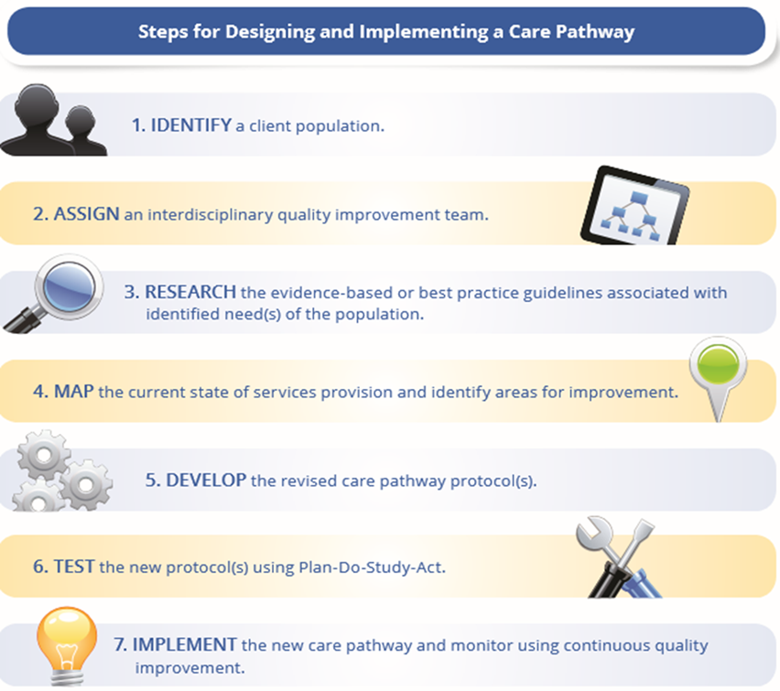
Care Pathway Implementation

Slide 27

“Transformation occurs, not at a steady & predictable pace, but in fits & starts. After the strenuous task of implementing a particular Patient Centered Medical Home component, the practice had to simultaneously manage the ripple effects, maintain the change, & prepare for the next…”
“…the work is daunting, exhausting & occurring in practices that already felt as if they were running as fast as they could. This type of transformative change, if done too fast, can damage practices and often result in staff burnout, turnover, & financial distress.”
Source: Nutting, Miller, Crabtree, et al. (2010) Effect of Facilitation on Practice Outcomes in the National Demonstration Project Model of the Patient-Centered Medical Home. Annals of Fam. Med., Vol. 8 (1). 533-544.

Slide 28

Jeff Capobianco
jeffc@thenationalcouncil.org

