Slide 1
Behavioral & Physical Health Services Integration: The Why & How for Behavioral Health Providers in 2025
November, 2025
Jeff Capobianco, PhD
JeffC@thenationalcouncil.org
Notes:
Laura

Slide 2
Discussion Topics
Why integration?
How the Certified Community Behavioral Health Clinic (CCBHC) model is different than traditional community mental health service approaches ?
What key knowledge and skills behavioral health care staff need to be successful in addressing their client’s whole health needs?
How the Comprehensive Health Integration Model (CHI) can be used to assess and develop a plan for health services integration?
Notes:
Laura

Slide 3
Defining Our Terms
How we define a “Term” determines how we structure beliefs and ultimately our behavior
Terms are at the core of how we think and act
Importantly, if policy makers, clinicians &/or administrators are not clear on the definition and source of their terms it is difficult to design or implement an integrated health model

Slide 4
Defining Our Terms
Some Integrated Health Term Sources:
Research Literature- ”Collaborative Care”
Policy- “Health Home”; “Certified Community Behavioral Health Clinic (CCBHC) Whole Health”
Accrediting Bodies- “Patient Centered Medical Home”
Provider Agencies- “Pt. Centered Healthcare Home”

Slide 5
Defining Integrated Health
“A practice team of primary care and behavioral health clinicians working together with patients and families, using a systematic and cost-effective approach to provide patient-centered care for a defined population. This care may address health behaviors (including their contribution to chronic medical illnesses), life stressors and crises, stress-related physical symptoms, and ineffective patterns of health care utilization.”
Peek CJ The National Integration Academy Council. Lexicon for Behavioral Health and Primary Care Integration: Concepts and Definitions Developed by Expert Consensus [AHRQ Publication No. 13-IP001-EF] Rockville, MD: Agency for Healthcare Research and Quality; 2013. Available athttp://integrationacademy.ahrq.gov/sites/default/files/Lexicon.pdf.

Slide 6

Why are we still talking about Integrated Health?

Slide 7

Integration: A New Initiative?
“The Body must be treated as a whole and not just a series of parts.”
--Hippocrates 300 BC
Notes:
As staff working intimately with people

Slide 8
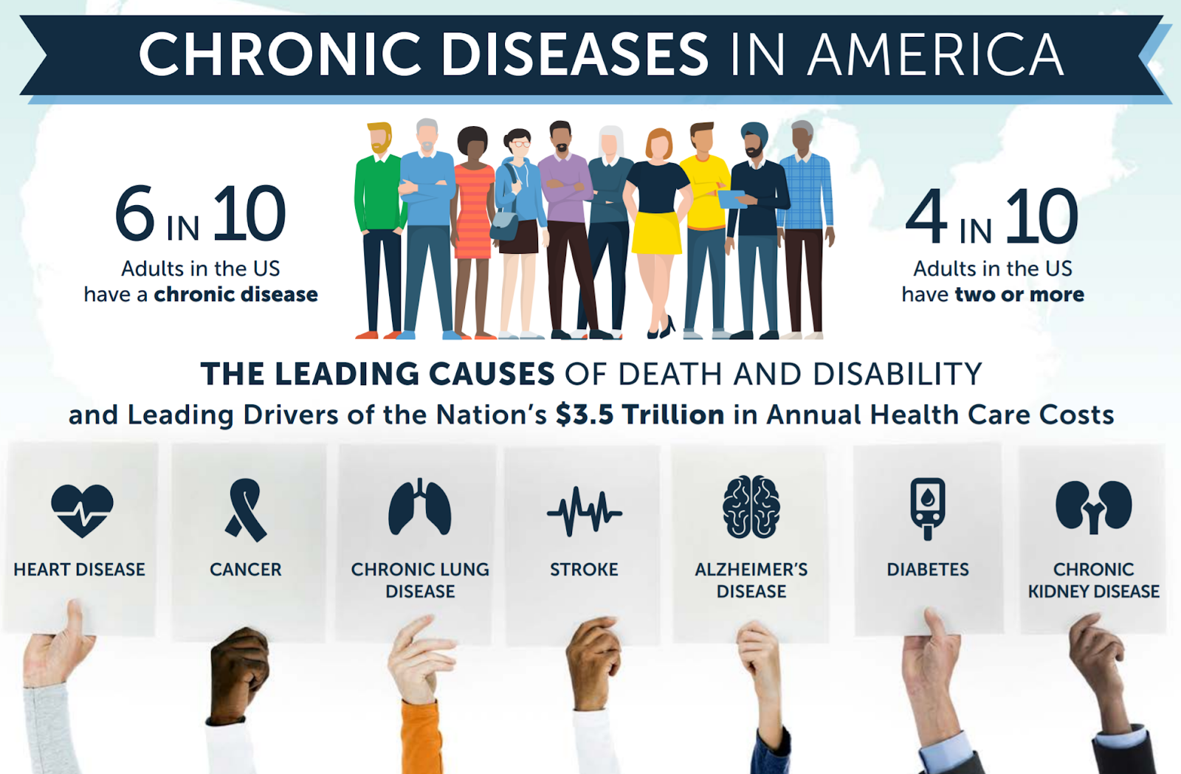
Why Consider the Whole Person?
https://www.nimh.nih.gov/health/publications/chronic-illness-mental-health

Slide 9
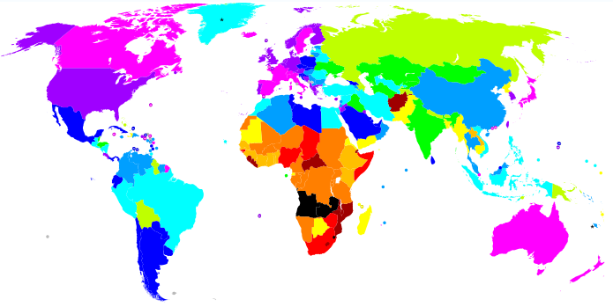


The 53 year lifespan
for people with Serious Mental Illness/Substand Use Disorders is comparable with Sub-Saharan Africa
9
9
Notes:
9

Slide 10
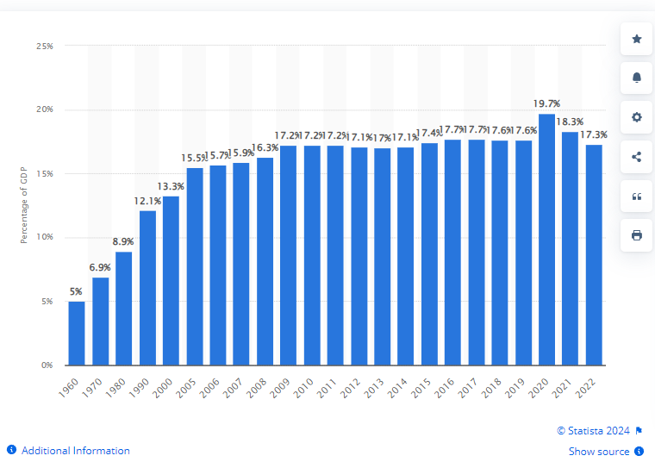
USA Healthcare Expenditure as % of Gross Domestic Product (GDP)

Slide 11
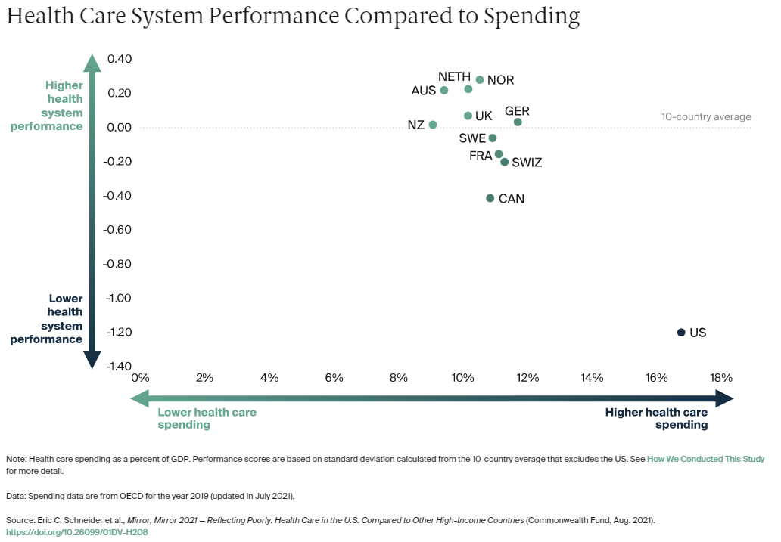

Slide 12
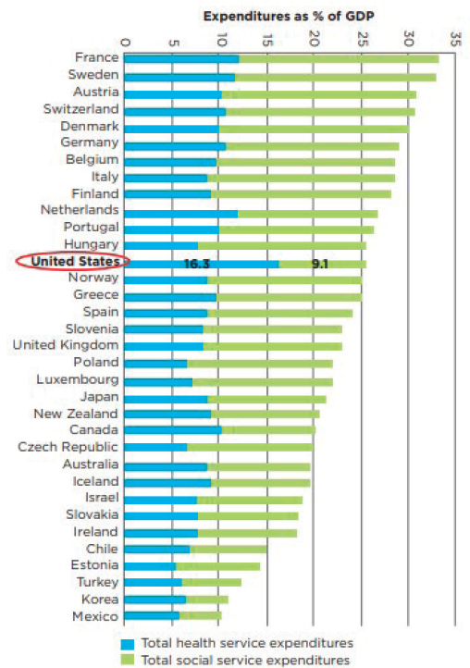
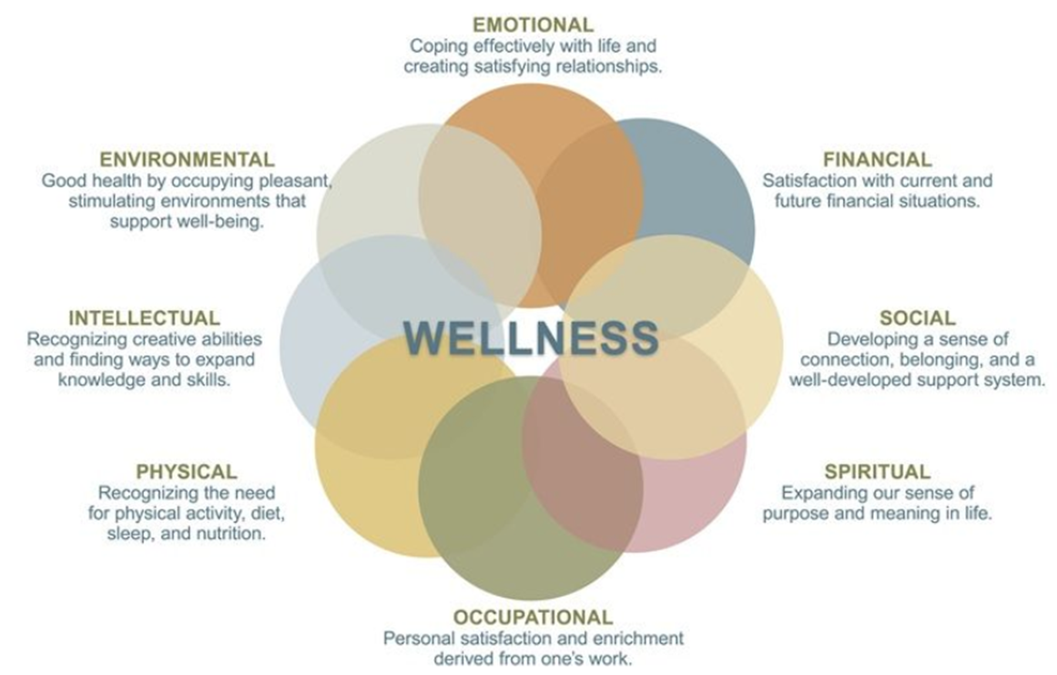
70% of Health Outcomes Correlated with SDOH
Source: The Evolution of the Quintuple Aim Health Equity, Health Outcomes,and the Economy Dipti Itchhaporia, MD, FACC, President, American College of Cardiology
Wellness Graphic: SAMHSA, Adapted from Swarbrick, M. (2006). A Wellness Approach. Psychiatric Rehabilitation Journal, 29(4), 311–314.
Expenditure Graphic: National Academies of Sciences, Engineering, and Medicine 2019. Integrating Social Care into the Delivery of Health Care: Moving Upstream to Improve the Nation's Health. Washington, DC: The National Academies Press. https://doi.org/10.17226/25467.

Slide 13
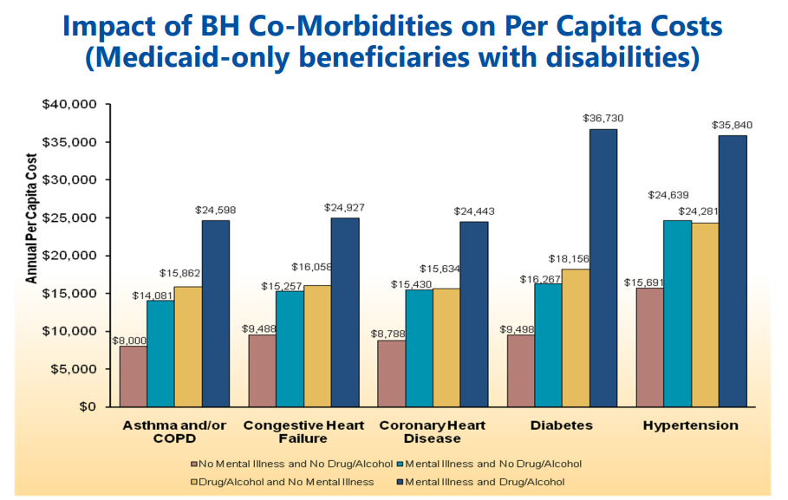
Boyd, C., Clark, R., Leff, B., Richards, T., Weiss, C., Wolff, J. (2011, August). Clarifying Multimorbidity for Medicaid Programs to Improve Targeting and Delivering Clinical Services. Presented to SAMHSA, Rockville, MD

Slide 14
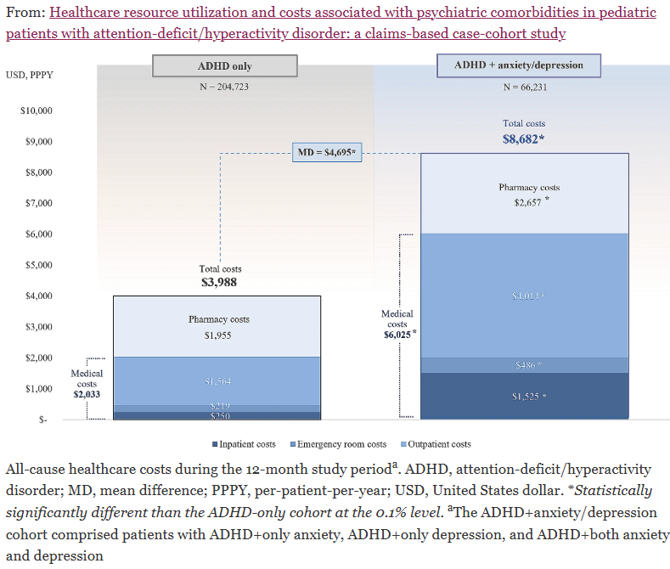
Schein, J., Cloutier, M., Gauthier-Loiselle, M. et al. Healthcare resource utilization and costs associated with psychiatric comorbidities in pediatric patients with attention-deficit/hyperactivity disorder: a claims-based case-cohort study. Child Adolesc Psychiatry Ment Health 18, 80 (2024). https://doi.org/10.1186/s13034-024-00770-8

Slide 15
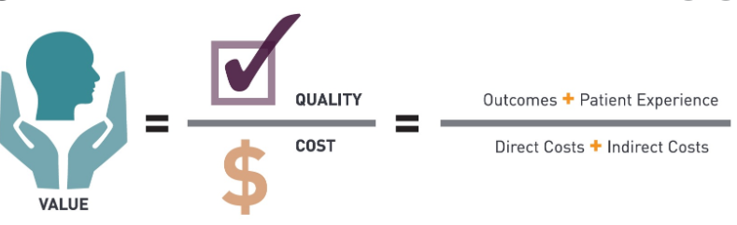
The Value Equation
Integrates Quality Data with Dollars
Staff Experience of Care Provision

Slide 16
Value-based Healthcare
Effective Healthcare:
  Producing quality outcomes, health literacy & customer satisfaction
Efficient Healthcare:
  Clinical & administrative processes that operate within optimal time & cost specifications
Fee-for-Service/Volume Based Care =>
Focus is on Efficiency
Value Based Purchasing =>
Focuses on Both Efficiency & Effectiveness

Slide 17
The Certified Community Behavioral Health Clinic (CCBHC)
A Whole Health Approach
Notes:
Jeff

Slide 18









CCBHC Scope of Services
Crisis
Services
Person-centered
and Family-centered Treatment Planning
Outpatient Mental
Health and Substance Use Services
Primary Care Screening and Monitoring
Targeted Case Management Services
Psychiatric Rehabilitation Services
Peer
Supports
and Family/
Caregiver Supports
Community Care for Uniformed Service Members and Veterans
CCBHC
Screening, Assessment and Diagnosis
Services may be delivered directly by the CCBHC or by a Designated Collaborating Organization (DCO). CCBHCs are expected to directly deliver the majority of encounters.
Provision of all services is person- and family-centered.
Notes:
Crisis Services – Managed by BH ASO
BH ASO Contracts with Providers
Providers are part of the ICN – They’re paid through the MCO>>ASO
What Psych Rehabs Are?

Slide 19
Federal & State CCBHC Actions Across the Country
18 States
Active CCBHC demonstration states
5 States*
CCBHC Model approved under an independent Medicaid pathway
15 States^*
2025 State Planning Grant Recipient^
13 States
At least 1 Clinic-level SAMHSA CCBHC Grantee
1 State
No State Certified or CCBHC Grantees
Notes: .
* Given that West Virginia has a planning grant and an Independent Medicaid Pathway, overall state count across categories is greater than 51.
^ Planning grant states also include West Virginia and Washington, D.C. Planning grants were awarded December 31, 2024, but for simplicity are referred to as 2025 Planning Grants given that they primarily cover the 2025 calendar year.

Slide 20
CCBHC Outpt. Clinic PC Screening & Monitoring
Criteria 4.G: 4.g.1
The CCBHC is responsible for outpatient primary care screening and monitoring of key health indicators and health risk.
The Medical Director establishes protocols that conform to screening recommendations with scores of A and B, of the US Preventive Services Task Force Recommendations for the following conditions:
  HIV and viral hepatitis
  Primary care screening pursuant to CCBHC Program

Slide 21
CCBHC Outpt. Clinic PC Screening & Monitoring
The Medical Director will develop organizational protocols to ensure that screening for people receiving services who are at risk for common physical health conditions experienced by CCBHC populations across the lifespan. Protocols will include:
Identifying people receiving services with chronic diseases;
Ensuring that people receiving services are asked about physical health symptoms;
Establishing systems for collection and analysis of laboratory samples

Slide 22
CCBHC Outpt. Clinic PC Screening & Monitoring
Monitoring includes the following:
1. ensuring individuals have access to primary care services;
2. ensuring ongoing periodic laboratory testing and physical measurement of health status indicators and changes in the status of chronic health conditions;
3. coordinating care with primary care and specialty health providers including tracking attendance at needed physical health care appointments;
4. promoting a healthy behavior lifestyle

Slide 23
Ok Great…but what does this have to do with me?
Notes:
Jeff

Slide 24
Who do we have in the room? What is of Interest to you?
Peers/Community Health Workers
Leadership
Therapists
Care Navigators/Managers
Psychiatric Staff
Nurses
Finance
IT
Anyone else?

Slide 25
Building an Integration Infrastructure
Staff Training:
Staff understand the impact of physical health conditions on behavioral health conditions (and visa versa).
Staff can provide health literacy/know how to talk to clients and their supports about the importance of physical health wellness behaviors, screening, and primary care engagement.
Staff are expert in motivational techniques for engagement and person-centered planning.
Measurement Informed Care:
Measurable care pathways for screening, monitoring, and coordinating care
Wellness, health promotion, and lifestyle modification programming
Care Coordination/Navigation:
Data tracking primary care engagement/referral
Memorandums of understanding/agreement with primary care and specialty care providers

Slide 26
The Comprehensive Health Integration (CHI)
Framework
Notes:
Jeff

Slide 27
SAMHSA Standard Framework for Integration
Referral |  | Co-Located |  | Integrated
Key Element: Communication |  | Key Element: Physical Proximity |  | Key Element: Practice Change
Level 1 Minimal Collaboration | Level 2 Basic Collaboration at a Distance | Level 3 Basic Collaboration On-Site | Level 4 Close Collaboration On-Site with Some System Integration | Level 5 Close Collaboration Approaching an Integrated Practice | Level 6 Full Collaboration in a Transformed/ Merged Integrated Practice
Behavioral health, primary care and other healthcare providers work:
In separate facilities. | In separate facilities. | In same facility not same offices/clinic (e.g., separate waiting areas). | In same space within the same facility but separate work flows/teams. | In same space within the same facility regular teaming & cross staffing. | In same space within the same facility, sharing all practice space (one clinic/one team).

Slide 28
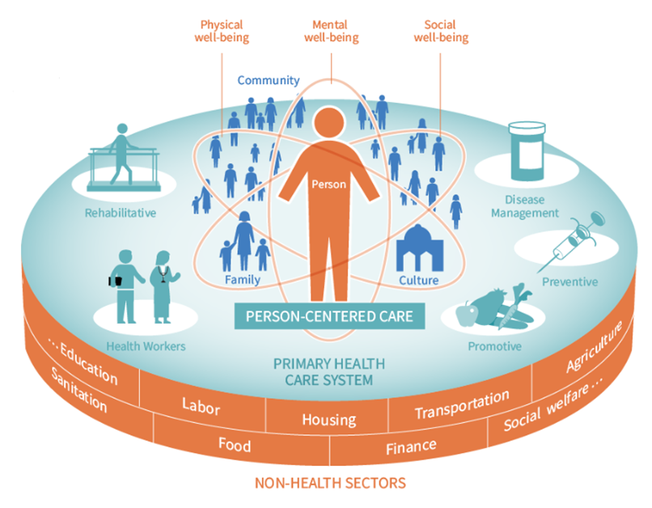
NEW!– The Comprehensive Healthcare Integration (CHI) Framework
The CHI Framework provides guidance on implementing the bidirectional integration of physical health and behavioral health to help providers, payers and population managers:
Measure progress in organizing delivery of integrated services (“integratedness”)
Demonstrate the value produced by progress in integrated service delivery
Provide initial and sustainable financing for integration

Slide 29
Integratedness vs Integration
Integration
The provision and coordination by a team of appropriately matched interventions for both PH, BH and SDoH, in the setting in which the person is most naturally engaged.
“Integratedness”
The degree to which practices are organized to deliver integrated PH, BH and SDoH screening/prevention and treatment services through defined processes and structures that support both the experience of care received and provided.

Slide 30
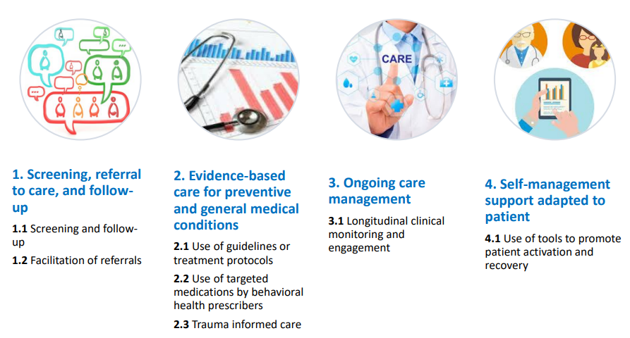
CHI Framework Domains & Subdomains
GHI Webinar: https://www.thenationalcouncil.org/webinars/advancing-integration-in-community-behavioral-health-using-a-new-general-health-integration-framework/

Slide 31
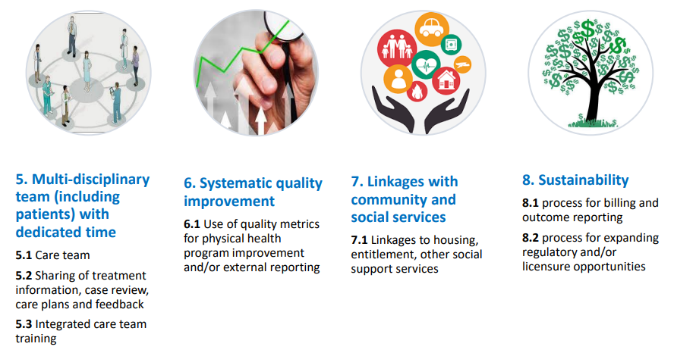
CHI Framework Domains & Subdomains

Slide 32

Domain One!
1.
Screening, referral to care and follow-up
1.1 Screening and follow-up for co-occurring behavioral health, Physical health (e.g., cardiovascular disease, asthma, diabetes, obesity, HIV, hepatitis) conditions and preventive risk factors (e.g., wellness behaviors).
1.2 Facilitation of referrals and follow-up
Notes:
Jeff

Slide 33
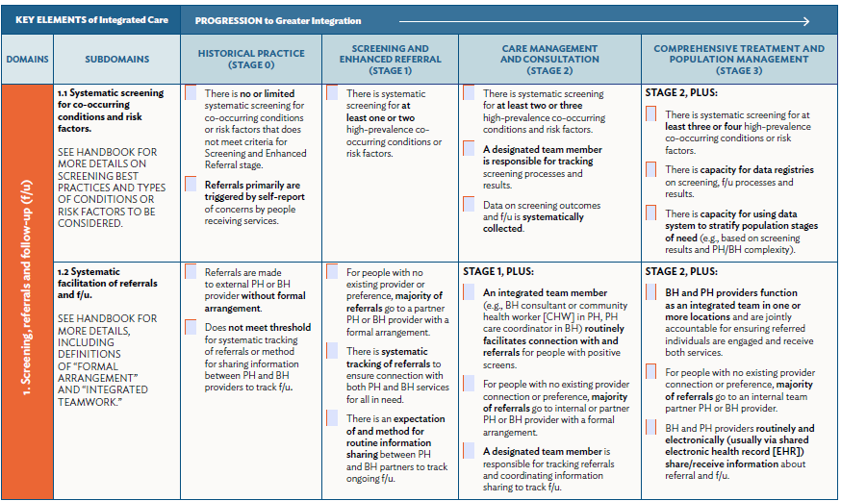

Slide 34
Historical Practice
Referral to external behavioral or primary care provider(s) triggered by self-report with no systematic follow-up.
No or minimal screening for physical health or substance use conditions.
Notes:
Jeff

Slide 35
Stage 1: Screening & Enhanced Referral
There is systematic screening for at least 1 or 2 high-prevalence cooccurring conditions or risk factors.
For people with no existing provider or preference, majority of referrals go to a partner PH or BH provider with a formal arrangement.
There is systematic tracking of referrals to ensure connection with both PH and BH services.
There is an expectation of and method for routine information sharing between PH and BH partners to track ongoing f/u.
Notes:
Jeff

Slide 36
Stage 2: Care Management & Consultation
Systematic screening for at least 2 or 3 high-prevalence co-occurring conditions and risk factors.
A designated team member is responsible for tracking screening processes and results.
Data on screening outcomes and f/u is systematically collected.
An integrated team member routinely facilitates connection with and referrals for people with positive screens. .
A designated team member is responsible for tracking referrals and coordinating information sharing to track f/u.
Notes:
Jeff

Slide 37
Stage 3: Comprehensive Tx & Pop. Health Management
Systematic screening for at least 3 or 4 high-prevalence co-occurring conditions or risk factors.
There is capacity for data registries on screening, f/u processes and results. There is capacity for using data system to stratify population stages of need
BH and PH providers function as an integrated team in one or more locations and are jointly accountable for ensuring referred individuals are engaged and receive both services.
BH and PH providers routinely and electronically share/receive information about referral and f/u.
Notes:
Jeff

Slide 38
Developing Your Action Plan
Based on what we have discussed, meet with your small group and identify potential action plans for your team. Right now, you are generating ideas that will be shared with your team, and your team will choose one plan.
This is a small action plan, can be done and measured in 30-60 days.
What will you do differently in your work?
What is the change you want to take back to your team?
What will be different/better for clients if you do this?
Is it small enough to be doable in 30-60 days and clear enough that you will know it is done?
Please write it down!!
Be ready to report out!

Slide 39

Notes:
Jeff

Slide 40
Resources
Agency for Healthcare Research and Quality (AHRQ) https://integrationacademy.ahrq.gov/
SAMHSA – Center of Excellence for Integrated Health Solutions https://www.thenationalcouncil.org/program/center-of-excellence/
Integrated Care Resource Center (ICRC)
(Focus is on State Level Integration Efforts)
https://www.integratedcareresourcecenter.com/state-integration-activities
Center of Excellence Oral Health Paper
https://www.thenationalcouncil.org/wp-content/uploads/2022/06/2022.06.23_NC_CoE_OralhealthMentalHealthSubstanceUseChallenges_Toolkit.pdf
Comprehensive Integrated Health (CHI)
https://www.thenationalcouncil.org/resources/the-comprehensive-healthcare-integration-framework/
Health Care Access Research and Developmental Disabilities (H-CARDD)
https://www.camh.ca/en/professionals/professionals--projects/hcardd/health-care-resources
https://www.camh.ca/en/professionals/professionals--projects/hcardd/health-care-resources/clinicians-and-service-providers

