Slide 1
Generational Trauma:
Understanding What It Is, Who It Affects, and How To Address It In Treatment
Maggie Canter, PhD
November 5, 2025

Slide 2
Overview and Goals
Define generational trauma
Identify who generational trauma affects
Learn strategies to treat generational trauma
Learn a technique to improve the attachment in the parent-child relationship and reduce behavioral problems

Slide 3
What is generational trauma?

Slide 4
Definition
Generational trauma refers to the psychological, emotional, and physiological consequences of traumatic events that are passed down from one generation to the next.
The effects of trauma experienced by caregivers can be passed down through epigenetic changes, parenting and attachment patterns, family dynamics, and communication patterns.
Can lead to attachment problems, relationship difficulties, and increase children’s susceptibility to anxiety disorders, depression, or PTSD.
Notes:
Epigenetic changes refer to modifications in gene expression that occur without altering the underlying DNA sequence, influenced by environmental factors and lifestyle choices

Slide 5
Who does generational trauma affect?

Slide 6
Las Madres Nuevas (Roubinov et al., 2021)
A large-scale study that follows 322 low-income Mexican-American mother-infant dyads from the prenatal period through 9 years of age
Maternal ACEs predicted more mental health and child behavior problems and negatively affected the mother-child dyadic functioning—don’t just affect the exposed individual!
Relationship-based dyadic therapy (in addition to individual and family-level treatment) in the postpartum period can improve both caregiver mental health and child behavior problems

Slide 7
Children (Pumariega et al., 2022)
Traumatic experiences (historical/generational trauma, immigration and acculturation stressors, natural and manmade disasters, experiences of discrimination, family violence, and community violence) disproportionately affect minority youth.
The most pivotal area for further research is on the impact of cumulative traumatic stress and historical trauma on minority/BIPOC children and families, which is critical for prevention efforts.

Slide 8
What are the treatment options?

Slide 9
Psychoeducation (Chockshi et al., 2023)
Psychoeducation on intergenerational trauma has the potential to reduce the health impact of traumatic exposures for caregivers and prevent traumatic exposures and chronic stress for their children.
Study of 21 adolescent mothers in a primary care clinic where they received a card that depicted generational trauma and its effects.
Mothers indicated they were very likely to change their behaviors based on what they learned.

Slide 10
Child-Parent Psychotherapy (Lieberman et al., 2005)
Child–Parent Psychotherapy (CPP) is a therapy for young children from birth through age 5 and their caregivers
CPP:
  Supports family strengths and relationships
  Helps families heal and grow after stressful experiences
  Respects family and cultural values
Goals:
  Improve children and caregivers’ mood, behaviors, trauma symptoms, stress, and relationships

Slide 11
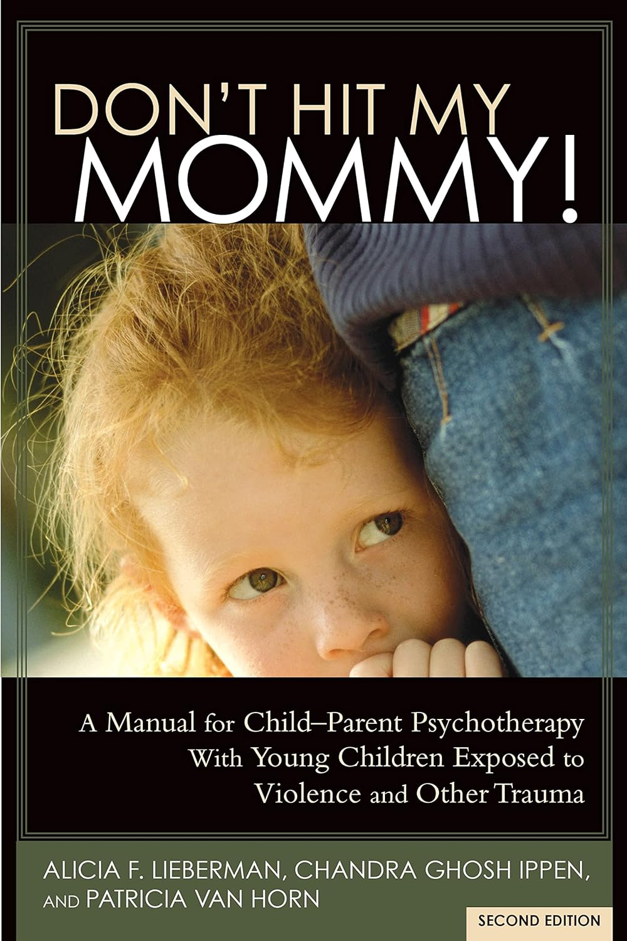
Child-Parent Psychotherapy
CPP sessions are usually weekly and involve the child and the caregiver but can involve some caregiver only sessions
Treatment targets include teaching caregivers and children to:
Understand each other
Talk and play about difficult experiences
Respond to difficult feelings and behaviors
Create a family story that leads to healing

Slide 12
Child-Parent Psychotherapy
Case Example:
  Who: mother in her 20s and her almost 2yo son
  Referred following a developmental evaluation that demonstrated child was delayed
  Mother had a history of neglect and abuse in her own childhood and prior to her most recent relationship was a victim of domestic violence
  Goal: Help mother learn skills to work through her trauma and build a healthy attachment with her child
  Length of treatment: 6 months

Slide 13
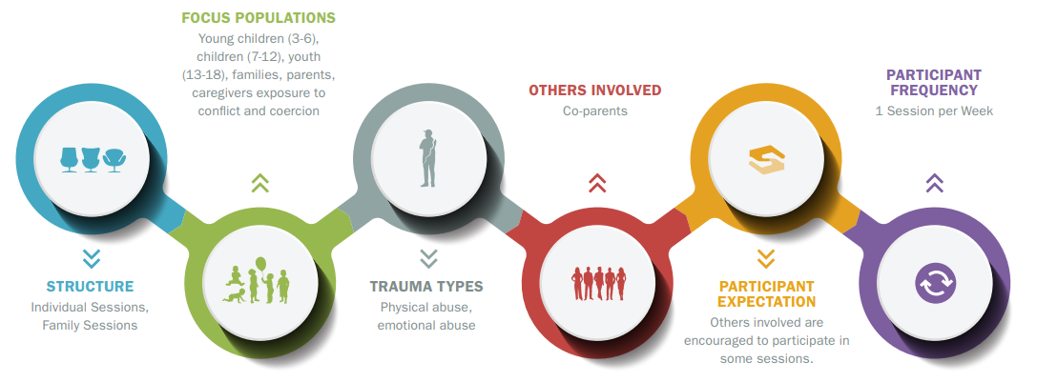
AF-CBT (Kolko et al., 2011)
Alternatives for Families: A Cognitive Behavioral Therapy (AF-CBT) is a trauma-informed, evidence-based treatment designed for abusive parents and their school-aged children

Slide 14

AF-CBT
Treatment targets:
  Engagement and Psychoeducation (e.g., learning about family experiences)
  Individual Skill-building (e.g., emotion regulation, noticing positive behavior)
  Family Applications (e.g., communication, problem solving).

Slide 15

AF-CBT
Goals:
  Support children and caregivers who are under stress and/or exposed to traumatic circumstances
  Improve child behavior and well-being and family safety
  Reduce risk for high conflict interactions
  Promote effective use of discipline and feedback with children

Slide 16
AF-CBT
Case Example:
  Who: mother, 7yo girl, and 17yo girl
  Referred by NY ACS following younger child’s disclosure of sexual abuse by her mother’s boyfriend to her teacher
  Older daughter had disclosed abuse to mother previously
    Mother was using
    Older sister felt guilty she did not prevent younger sister’s abuse
  Goal: keep these children with their mother, improve their relationships, and teach mom healthy coping strategies
  Length of treatment: 6 months

Slide 17
Parent-Child Interaction Therapy
PCIT is a dyadic treatment that was initially developed to treat child behavior problems but has since had many adaptations.
Traditional PCIT has 2 phases of treatment
  CDI: relationship focused on building strong attachment
  PDI: discipline focused
PCIT has been used to treat children who experienced trauma but did not directly address trauma in treatment
TDI (Gurwitch & Warner-Metzger, 2022) keeps the traditional core skills of PCIT and adds in adding sessions to cover psychoeducation about trauma, caregiver response to a child’s trauma reactions (SAFE skills), and coping skills to aid both the child and the caregiver to manage trauma activators (COPE skills)

Slide 18
Parenting Styles

Slide 19
Four Parenting Styles (Baumrind; Maccoby & Martin)
HIGH ON RULES
1. Authoritarian: Rules and consequences with little warmth
2. Authoritative: Rules with limits and lots of warmth
LOW ON WARMTH
HIGH ON WARMTH
4. Neglectful: Few rules and limits and little warmth
3. Permissive: Few rules and limits with lots of warmth
LOW ON RULES
Notes:
What do you think our parenting goal is?

Slide 20
Our Parenting Goal!
Authoritative
The “just right” parenting style
Warm and firm
Responsive to child’s needs
Clear rules and limits
Encourage independence safely
  Making choices
  Unstructured play
  Scaffolding new skills

Slide 21
Does trauma affect parenting?
Yes!
How do you think it could affect individuals who may lean towards each of the 4 parenting styles?
  Authoritarian
  Authoritative
  Permissive
  Neglectful

Slide 22
Relationship Building Skills

Slide 23
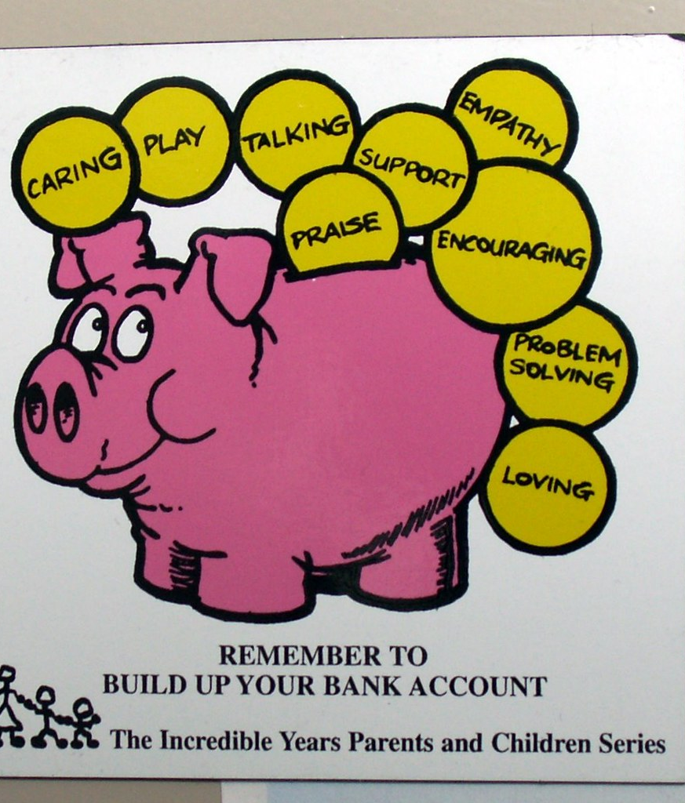
Creating a strong parent-child relationship through play
Parent: Learns therapeutic parenting skills, to manage your child’s behaviors with positive attention alone, to use active listening with your child
Child: Improves their self-esteem, develops their social skills, increases their frustration tolerance, attends longer to play activities, and increases use of manners and positive attention seeking behaviors
Relationship: becomes stronger, warmer, and more mutually enjoyable
Notes:
You work harder if you like your boss-same applies for kids

Slide 24
How much time do parents need to spend with their child to have a positive impact on child behavior?
Daily 1:1 Time
Follow their lead in choice for play
5 minutes per day : Long enough to provide a therapeutic effect,
but short enough to not be time consuming or frustrating
No criticisms, commands, or questions during this time
So, what do you do instead?
Notes:
Commands take away the lead from the child, and play can stop being enjoyable if the child misbehaves.
Questions can take lead of conversation, suggest they are doing something wrong, take control of play, suggest you are not listening.
Criticism provides negative attention, suggests that disapproval, makes play less enjoyable.

Slide 25
PRIDE Skills
Praise | Provide specific, labeled praise to appropriate behaviors that you like.
Reflect | Reflect appropriate speech and sounds to increase language skills.
Imitate | Join in the play and imitate what your child is doing
Describe | Observe and describe what your child is doing out loud
Enjoy | Show genuine enjoyment during this time! HAVE FUN!

Slide 26

Provide specific, labeled praise to appropriate behaviors that you like.
  “Nice job!” vs “Nice job putting those toys away!”
  You can use labeled praise to improve problem behaviors before they occur.
    For example, what is the opposite of running in the house? Hitting siblings?
Praise
Notes:
Compliments a child on their behavior.
Labeled praises:
More effective; lets child know exactly what you like
Behavior that is praised is more likely to be repeated
Boosts child’s self-esteem

Slide 27
Child: That crayon is blue!
Reflect on your child’s appropriate talk.
Repeat/paraphrase child’s statements.
  This skill may feel awkward at first!
Reflect
Parent: That crayon is blue!
Notes:
Allow child to lead conversation
Shows that you are listening
Shows acceptance and understanding of what child
is saying
Improves and increases child’s speech

Slide 28



Play with the toys your child is playing with.
If your child switches to a new activity, follow along!
  Keep play at your child’s developmental level.
Imitate
Notes:
Helps keep attention and comments focused on
your child
Lets your child lead
Makes play fun for your child
Shows approval of your child’s activity
Teaches your child how to play well with
others

Slide 29
You are racing your cars around the track!
Provide behavior descriptions of what your child is doing.
Do not focus on what you or the toys are doing.
  You “You ___” statements.
Describe
You are putting the red block on the blue one!
Notes:
Lets child lead the play
Shows you are interested and paying attention
Models speech and teaches vocabulary and concepts
Shows approval of child’s behavior
Helps increase child’s attention span and persistence
with activity
Encourages child to slow down and think about their
actions
Supports development of child’s self-talk or internal
monologue

Slide 30
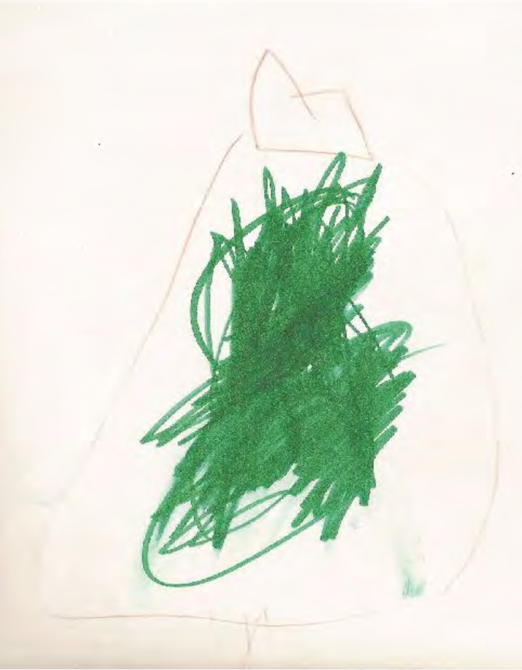
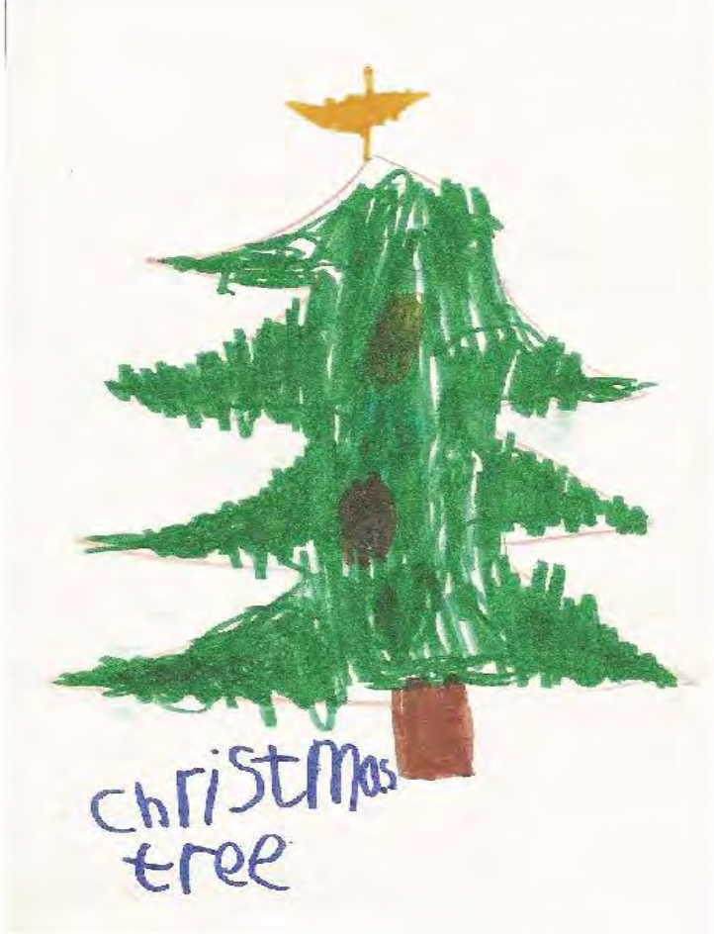
Without Behavior Descriptions
Describe
With Behavior Descriptions

Slide 31
I am having such a fun time playing with you!
Show that you are happy to play with your child.
  Use an interested, enthusiastic tone.
  Use laughter.
  Provide physical affections.
Enjoy
I love when we play race cars together!
Notes:
Increases warmth of your play
o Makes Special Time more fun and meaningful
for your child

Slide 32
Misbehavior During Special Time
Children love attention, and behavior that gets the most attention is likely to be repeated!
  Ignoring behavior reduces negative behavior:
    Maximizes contrast between:
      Appropriate behavior and labeled praise
      Inappropriate behavior and ignoring.
Notes:
Children prefer negative attention over none.

Slide 33




Special Time Activities
Activities for Using PRIDE Skills
Creative &
Constructive
Imaginative Play
Make believe toys with no rules (e.g., dolls, dress-up cars, play kitchen/store)
Art projects, crafts, building sets, blocks, magnet tiles, coloring
Movement
Cooking
Dancing and jumping with your child
Get in the kitchen (may also reduce picky eating!)
Notes:
Things to avoid: playdoh, paint, etc.

Slide 34
Modeling Resiliency
Notes:
Demonstrate to parents that they are the role model for resiliency and emotional control.

Slide 35
Children will learn how to manage emotions and behaviors from peers, media, and other sources—but you can guide them by providing accurate and supportive information.
Parents are the best source of information and model of behavior for your children.
Notes:
You are the best source of information and model of behavior for your children.

Slide 36
When parents model emotional control, children learn how to navigate their own emotions, build resilience and engage in coping skills that support their success.

Slide 37


Challenges to Modeling Emotional Control
Daily Hassles
Limited time with their children
Money, responsibilities, lack of support
What are some other things you can think of?
Negative Thinking Patterns
Worries about what others will think
Worries that they will say something wrong
Examples from your cases?
Notes:
Clinician consideration: parent coping skills and emotion regulation

Slide 38
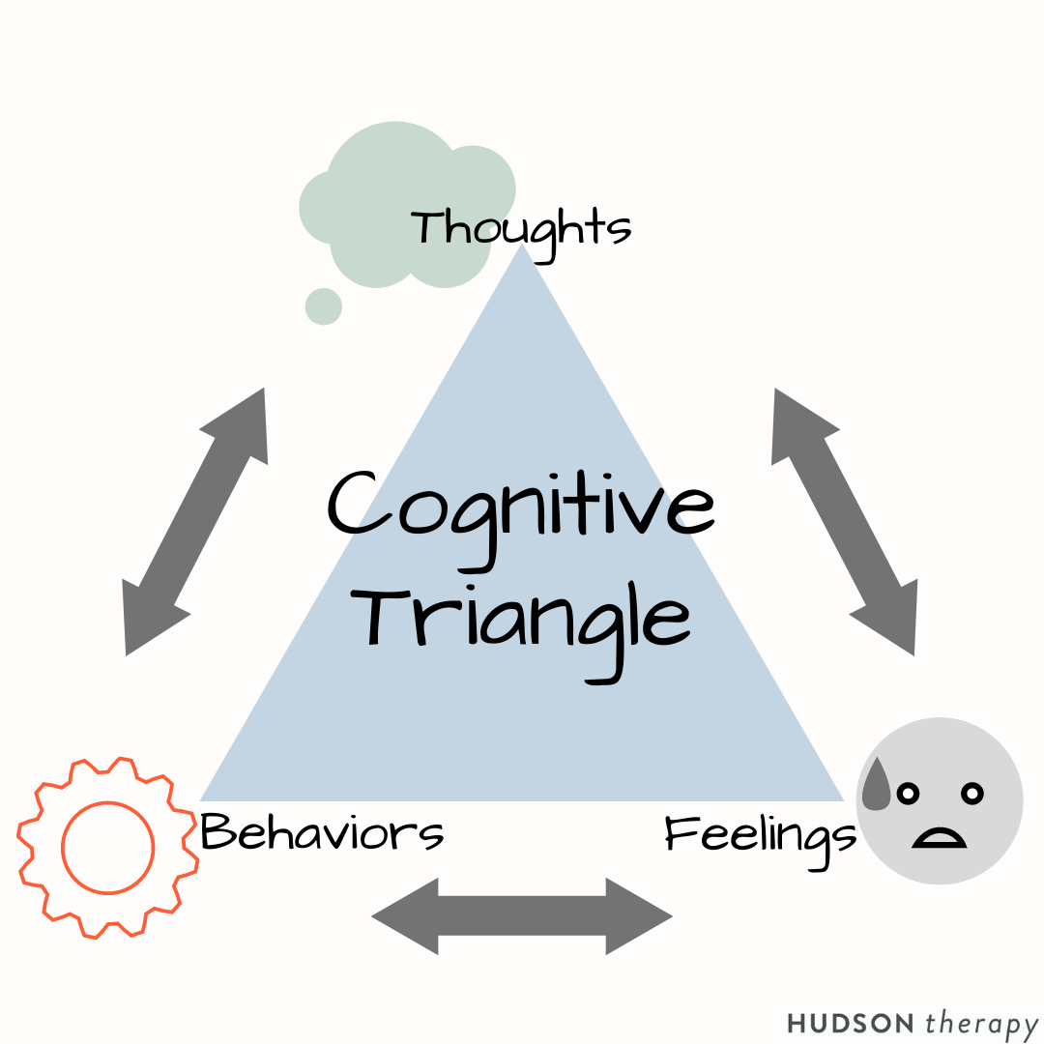
Does how someone thinks matter?
The way we think is associated with our feelings, behavior, and consequences of that behavior.
David Kolko, Dr. Brown and others (2011) have developed a diagram to understand this (next slide)

Slide 39



Challenging Negative Thinking
He did that on purpose.
Angry, Resentful
Cursing, Unsafe Driving
Arrest, Car Accident
Cut Off In Traffic
Thoughts
Feelings
Behaviors
Consequences
It was an accident.
Calm
Safe Driving
Nothing
Notes:
Here is an example to illustrate this concept.
Thoughts often happen automatically – without awareness (not always conscious)
can change behavior
sometimes hard to generate new thoughts that can change our reactions

Slide 40
Challenging Negative Thinking
  Notice the thought—is it inaccurate or unhelpful?
  What are the feelings associated with that thought?
  What behaviors are associated with that thought?
  What are the consequences of those behaviors?
  Let feelings and behaviors flow from more accurate, helpful thoughts.
Notes:
Our moods and thoughts when children misbehave can cause us to lose our cool
Instead, we need to Consider Alternative Thoughts
Remember this example…

Slide 41
Ways to Help ParentsModel Emotional Control
Encourage them to talk aloud when they are having/had a stressful moment to show how they solve problems and handle strong emotions.
Convey comfort in talking about upsetting topics (even if they are not).
Help their child identify and manage emotions—at the right time! Strike when the iron is cold.

Slide 42
When parents model respectful communication, children learn to navigate challenges, build positive relationships, and advocate for themselves effectively.

Slide 43




Modeling Respectful Communication
  As the mental health provider, you can model respectful communication in sessions and help the family learn to use it with each other
  Encourage parents to:
  Talk the way they want their children to talk.
  Talk as if they are being watched.
Model with their partner/spouse.
Model with their children.
Model with strangers.
Model with people with differences.
Notes:
Think: “What if my minister were watching?”

Slide 44
Modeling Respectful Communication
Constructive Criticism
Shaming
“I” Talk
VS
Shaming
VS
“You” Talk
  Words: Labeling the behavior versus personality trait/jargon
  Tone: Neutral voice versus sarcasm/ aggression
  Own your feelings and thoughts—nothing bothers everyone
  ”I am getting frustrated” vs ”You never listen”

Slide 45
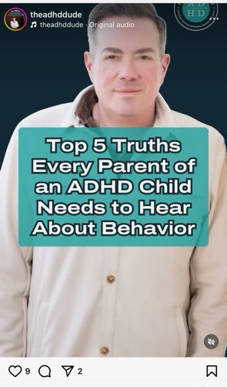
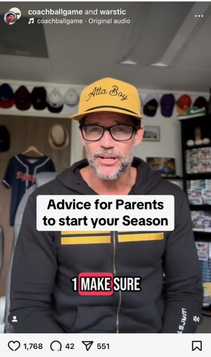
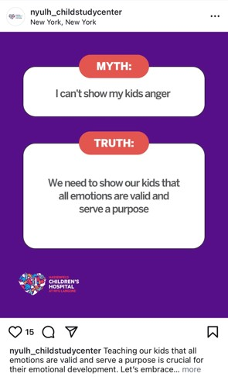
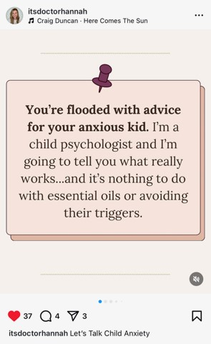
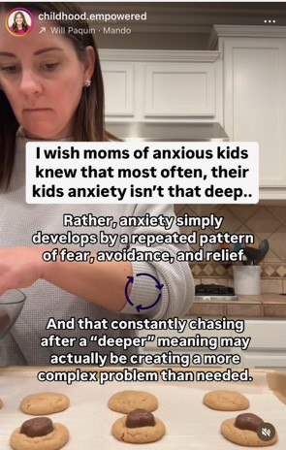
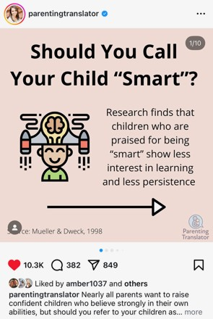
Parenting Influencers
Check the facts!
What is the training of the individual providing the information?
Does it generally make parents feel good about their parenting/relationship with their child or bad?
Made up diagnoses (e.g., Pathological Demand Avoidance)
Some of my favorites!
Follow me on Instagram for evidence-based parenting tips @mfcpsych

Slide 46
References
Chokshi, B., Pukatch, C., Ramsey, N., Dzienny, A., & Smiley, Y. (2023). The generational trauma card: A tool to educate on intergenerational trauma transmission. Journal of Loss and Trauma, 28(5), 464-471.
Gurwitch, R. H., & Warner-Metzger, C. M. (2022). Trauma-directed interaction (TDI): an adaptation to parent-child interaction therapy for families with a history of trauma. International Journal of Environmental Research and Public Health, 19(10), 6089.
Kolko, D. J. (1996). Individual cognitive behavioral treatment and family therapy for physically abused children and their offending parents: A comparison of clinical outcomes. Child Maltreatment, 1(4), 322-342.
Kolko, D. J., Iselin, A. M. R., & Gully, K. J. (2011). Evaluation of the sustainability and clinical outcome of Alternatives for Families: A Cognitive-Behavioral Therapy (AF-CBT) in a child protection center. Child Abuse & Neglect, 35(2), 105-116.
Lieberman, A. F., Van Horn, P., & Ippen, C. G. (2005). Toward evidence-based treatment: Child-parent psychotherapy with preschoolers exposed to marital violence. Journal of the American Academy of Child & Adolescent Psychiatry, 44(12), 1241-1248.
Pumariega, A. J., Jo, Y., Beck, B., & Rahmani, M. (2022). Trauma and US minority children and youth. Current psychiatry reports, 24(4), 285-295.
Roubinov, D. S., Luecken, L. J., Curci, S. G., Somers, J. A., & Winstone, L. K. (2021). A prenatal programming perspective on the intergenerational transmission of maternal adverse childhood experiences to offspring health problems. American Psychologist, 76(2), 337.

Slide 47
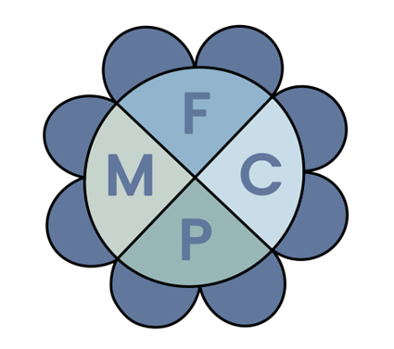

Questions?
My Contact Info:
MFC Psychology Services
www.margaretcanterphd.com
Maggie@margaretcanterphd.com
205-259-8472
My Intstagram: @mfcpsych
UAB Department of Pediatrics
margaretcanter@uabmc.edu

