Slide 1

Medication for Behaviors
11/05/2025
In the Intellectually Disabled Population
Andrea Thomas, MD

Slide 2
Why this matters
Many children and adults with an intellectual disability (ID) exhibit “challenging behaviors” such as aggression, self-injury, property destruction, or repetitive behaviors.
These behaviors affect quality of life, safety, support needs, and are very stressful for families and caregivers.
Medication is one tool among many that is commonly used.
Because many non-medical people are involved in supporting our patients, it’s helpful to know what medications are used, how well they work (or don’t), and what to watch out for.

Slide 3
Medication for Behaviors
What we mean by “behavioral issues”
Definitions: Challenging behavior that impairs the person’s ability to function in the setting and maintain relationships
Examples: hitting others, biting, head-banging, kicking, property destruction, aggression, repetitive stereotyped behaviors.
These behaviors may stem from multiple causes (communication difficulties, unmet needs, pain, environment, psychiatric issues).
Important point: medication is not a substitute for understanding underlying causes and providing behavioral plans.

Slide 4
Medication for Behaviors
Objectives
What are the major categories of medications used for behavior interventions
1.
How do medications achieve goal of reducing behaviors?
2.
3.
What are the side effects generally and what may be behavioral issues that are from the medications themselves?

Slide 5
Medications for Behaviors
1.
What are the major categories of medications used for behavior interventions?
Antipsychotic medications
Antiepiletic medications
Antidepressant medications
Dopamine impacting medications
Lithium
Beta blockers/ alpha agonists

Slide 6
Medications for Behaviors
Antipsychotic medications
1) Typical–thorazine, haldol, trilafon, mellaril, loxapine, prolixin
2) Atypical (2nd generation) Clozaril, Risperdal, Zyprexa, Abilify, Geodon
3) Newer iteration–Vraylar, Rexulti, Fanapt
4) 4th generation–Caplyta
They all reduce dopamine by binding to the D2 receptors and blocking release. Caplyta is both D2 and D3. The side effect profiles and how tightly they bind to different receptor sites differentiate the different medications.

Slide 7
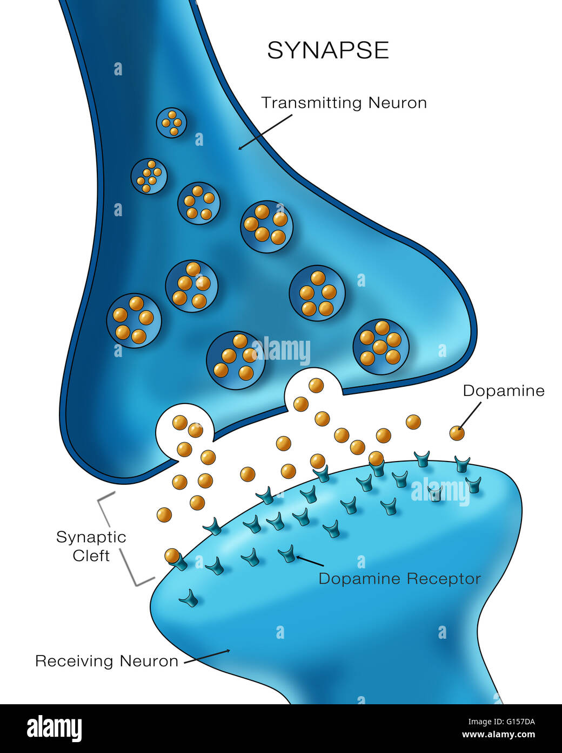
Model of a nerve
Synapse
This represents dopamine, but one can substitute any neurotransmitter into this scenario to picture how nerves communicate. The “signal” dopamine is released from one side and binds to receptors on the other side.

Slide 8
b) Antiepileptic medications
Depakote, Trileptal, Tegretol, Lamictal
Neurontin, Lyrica
Klonopin, Ativan, Xanax, Valium
The first group work on sodium channels on nerves to change how the nerves fire. The rest of the medications actually work like brakes to slow down a car.

Slide 9
c) Antidepressant medications
1) SSRI–Zoloft, Paxil, Lexapro, Celexa, Trintellix
2) SNRI–Cymbalta, Effexor, Pristiq
3) Tricyclics–Imipramine, Nortriptyline, Amitriptyline
4) Other: Wellbutrin, Remeron, Buspar
Can help with anxiety, irritability, sleep regulation, impulse control, ADHD symptoms, appetite regulation, migraine prevention, bed wetting, irritable bowel syndrome.

Slide 10
d) Dopamine modifying medications
Stimulants–Methylphenidate, Dextroamphetamine
Amantadine
Requip, Mirapex
Naltrexone
These can help with restless leg symptoms and depression, irritability, temor, impulsivity, and executive functioning. Amantadine specifically is part of the Matthews treatment protocol for Disruptive Mood Dysregulation Disorder. Naltrexone blocks opiate receptors in the reward system to decrease the dopamine reward with repetitive SIB, irritability, and stereotyped behaviors. Also can potentially help attention and social communication.

Slide 11
Lithium Carbonate and Lithium Orotate
There are multiple ways that lithium acts including on glutamate reuptake by NMDA receptors, increases GABA, increases serotonin synthesis, regulated dopamine, increases BDNF and B-cell lymphoma-2 which helps nerve plasticity and function, nerve survival, and nerve growth.
Lithium signals autophagy and clearing of damaged cells and proteins. It also directly and indirectly impacts glycogen synthase kinase 3 (GSK-3) which regulates inflammation, mood and neuroprotective effects.
Inositol depletion is another effect that lithium has which triggers recycling of inositol to then turn down the excessive downstream signaling of nerve activation

Slide 12
f) Beta Blockers and Alpha Agonists
Propranolol, Labetalol, Bisoprolol
Clondine, Guanfacine, Prazosin
Beta blockers are widely used as they have immediate effects on one’s central nervous system to decrease activation, anxiety, pulse rate, and tremor. They have no addiction risk with tolerable SE profile.
Alpha agonists help with ADHD symptoms by increasing norepinephrine at the prefrontal cortex. They typically do not increase anxiety and can help with transitions and restlessness.

Slide 13
Evidence for Medication
A 2015 systematic review/meta‐analysis (children with ID) found the following:
Antipsychotic medications (e.g., risperidone, aripiprazole) did reduce challenging behaviour in the short-term (effect sizes moderate to large). PMC+1
But there were significant side effects: elevated prolactin, weight gain. PMC
Evidence for anticonvulsants/antioxidants was inconclusive. PMC+1
And long-term follow-up data are missing; quality of studies was low. PubMed

Slide 14
A 2020 study of 71 adults with ID in crisis settings found:
Everyone was on at least one psychotropic; average ~4 medications. PubMed
85% were on antipsychotics, and many did not have a psychosis diagnosis. PubMed
Side-effects were high, especially central nervous system ones. PubMed
A 2013 Cochrane review on self-injury in adults with ID found weak evidence for benefit of naltrexone or clomipramine; trials were small and high risk of bias. PubMed

Slide 15
Medications for Behaviors
Antipsychotic medications: reduce aggression, irritability, severe behavioral outbursts, self-injury, and help with transitions, tics, perseveration.
What to watch for:
Weight gain, metabolic changes (urination at night) PMC+1
Breast development, leaking milk, menstrual cycle problems PMC
Sedation / drowsiness
Movement disorders–slow walking, tremor, muscle stiffness, looking up repeatedly.
Because folks with ID can’t reliably report feelings ( sedation, discomfort), caregivers need to watch behavior, physical signs (sleepiness, weight gain, constipation)
Regular review is essential: dose, necessity, side-effects, alternative supports. PubMed+1

Slide 16
Medication for Behaviors
Mood stabilizers: help lessen mood swings, irritability, impulsivity; sometimes used when there is epilepsy & behavior issues.
What to watch for:
Changes in appetite or weight, new rash
Sleepiness, falling, incoordination
Cognitive slowing, attention, or memory problems
Motor tics or twisting movements
Hair thinning

Slide 17
Medication for Behaviors
Antidepressants: reduce aggression, irritability, behavioral outbursts, and self-injury and promote sleep, positive moods and resilience that are worsened by anxiety or depression.
What to watch for:
Weight gain, decreased appetite (Wellbutrin, Prozac, Cymbalta), diarrhea, nausea PMC+1
Activation syndrome (more hyperactivity, irritability and restlessness)( PMC)
Sedation, drowsiness–especially Remeron, TCA, Trazodone
Headaches, dizziness–sometimes this can present as increased HSIB.
Akasthisia–rare 1-2/1000 people with significant restless leg type symptoms, disrupts sleep
Increased bruising, especially if on NSAID as well.
Dry mouth, increased thirst, urinary retention

Slide 18
Medication for Behaviors
Beta Blockers and Alpha Agonists: decrease anxiety, central nervous system activation, heart rate, tremors, impulsivity, irritability, oppositional behavior and tics; improve focus, sleep and nightmares.
Mood changes: more anger, agitation, or the opposite with depression
Changes in sleep: insomnia ( a agonists work on NE) or sleeping too much
Signs of pain from constipation, HA (can be side-effect but also underlying cause of behavior)
Reduced responsiveness to environment, apathy, increased reactivity to nothing–? AH/VH
Physical health changes: dental hygiene poor from dry mouth, weight gain from decreased hyperactivity, hair loss with B blocker

Slide 19
Medications for Behaviors
Serotonin Syndrome and Neuroleptic Malignant Syndrome–save a life
Muscle rigidity, spasticity repeatedly
Fever, BP and heart rate instability
Increased confusion–inability to do regular activities
Preceded by increased anxiety, jitteriness,restlessness
Preceded by increased nausea and diarrhea
If you see any of the above alert the mental health provider.

Slide 20
Medication for Behaviors
Toxicities
Lithium–incoordination, slurred speech, muscle spasms, tremor, confusion. Occurs when dehydrated, diarrhea, vomiting. Get clarification from mental health–generally wait until GI bug is over.
Tegretol/trileptal–Quit if rash all over starting on chest/ face. Dizziness, incoordination, muscle spasms all over, twisting movements like TD, coma and seizures.
Depakote–nausea, vomiting, slurred speech, irritability, falling down, confusion, yellow skin or eyes, slowed breathing, easy bleeding or bruising.

Slide 21
Medication is not a magic fix for behavior. It should always be used alongside behavior support, environmental modifications, social interventions, routine schedule.
Always ask why the medication was started and what behavior was it targeting? Track behaviors.
Understand who monitors the medication: prescribing doctor, pharmacist, nurse, support team. Clarify who will review dose, need, side-effects, plan to stop or reduce.
Ensure regular reviews: Sometimes people stay on medications for long periods without re-evaluation of continued benefit vs. risk. PubMed
Monitor and document both behavioral outcomes (is the behaviour really better?) and side-effects (are we seeing negative physical/mental/behavioural changes?).
Encourage a team approach: family + staff + prescribing clinician + behavior specialist + teachers.
Advocate for least possible dose, shortest possible duration (when feasible), and regular “pause & review”.
Support physical health alongside: nutrition to include 30+ plants per week, movement, sunshine in AM

Slide 22
Questions
What have you seen in your settings (children/adults) with behavioral medication?
What side-effects do you monitor now?
What supports could be improved to ensure regular review?
What questions would you ask the prescriber about the medication?

Slide 23
Medication for Behavior
References for further reading
Rana F, Gormez A, Varghese S. Pharmacological interventions for self-injurious behaviour in adults with intellectual disabilities. Cochrane Review 2013. PubMed
McQuire C, Hassiotis A, Harrison B, Pilling S. Pharmacological interventions for challenging behaviour in children with intellectual disabilities: systematic review & meta‐analysis 2015. PMC
Charlot LR, Doerfler LA, McLaren JL. Psychotropic medications use and side-effects in individuals with IDD. J Intellect Disabil Res. 2020. PubMed
Janowsky DS, Shetty M, Barnhill J. Serotonergic antidepressant effects on aggressive, self injurious and destructive/ disruptive behaviours in intellectually disabled adults. Int J Neuropsychopharmacol. 2005. Mar;8(1):37-48.
Valdovinos MG, Schieber E, McMahon M. Adverse Side Effects of Psychotropic Medication and Challenging Behavior: Pilot Work Assessing Impact. J Dev Phys Disabil. 2017 Nov 2;29(6):969–982.

