Slide 1

When Is A Behavior Something More?
How to better identify dual diagnosis mental health conditions in neurodevelopmental disability clients
Presented by
Jennifer Sheehy-Knight, PhD
Licensed Psychologist
Alabama Developmental & Behavioral Specialists

Slide 2
Objectives
Recognize common comorbid diagnosis in the neurodevelopmental disability (NDD) population, particularly in children and adolescents.
Demonstrate understanding of common symptoms in the NDD population that overlap mental health conditions.
Recognize indicators of mental health diagnosis in the NDD population and feel more comfortable with knowing when to refer for further assessment.

Slide 3
Neurodevelopmental Disability
In the United States, about 1 in 6 children are considered to have a developmental disability.
Developmental disabilities are a group of lifelong conditions due to an impairment in physical, learning, language, and/or behavior areas of functioning which begin in childhood.

Slide 4
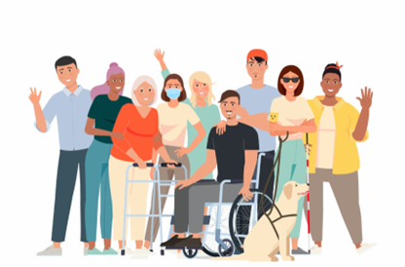
The broadest definition includes…
  Intellectual Disability
  Hearing or Vision Impaired
  Cerebral Palsy (CP)
  Global Developmental Delay
  Autism Spectrum Disorder (ASD)
  Fetal Alcohol Spectrum Disorders
  Fragile X Syndrome
  Attention-Deficit/ Hyperactivity Disorder
  Language and Speech Disorders
  Down Syndrome (DS)
  Other Disability

Slide 5
Focus today…
Intellectual Disability (Intellectual Developmental Disorder) is a disability characterized by significant limitations in both intellectual functioning and adaptive behavior which originates during the developmental period
  Intellectual functioning/Cognitive ability measured through standardized testing (IQ test) below 75
  Adaptive behavior is how well the person meets the societal standards for personal independence compared to similar-aged peer
    Conceptual domain (functional academic skills)
    Social domain (maturity, social judgment, less complex language)
    Practical domain (daily living skills such as dressing, meals, bathing, toileting)
Notes:
Previos 70- stll cutoff for state

Slide 6
Focus today…
Intellectual Disability (Continued)
  Range of Levels
    Mild (e.g., learning difficulties but may function at age level with common personal care tasks)
    Moderate (e.g., extended period of teaching to learn personal care skills but does acquire skill)
    Severe (e.g., requires support and supervision to complete daily living skills)
    Profound (e.g., fully dependent on others for care)
  Developmental period now extended to age of 22
  Prevalence: 1-2 in 100 in the United States
Developmental Delay is characterized by delays in one or more developmental area (motor, cognitive, language, socioemotional, adaptive) under the age of five (or nine for the school setting)

Slide 7
Co-Morbidity of Psychiatric or Mental Health conditions

Slide 8
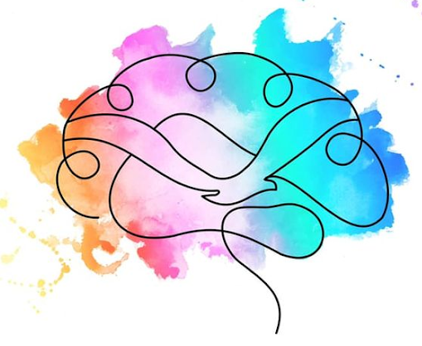
Co-Morbidity in ID/DD Populations
Co-Morbidity rates vary greatly depending on the study (up to 74%) but most common estimate is that roughly about one-third of individuals with ID/DD also meet the criteria for a psychiatric or mental health condition. Compared to 13% of the general population.
Psychiatric disorders occur at least 3x more often in youth with ID/IDD than with TD.
Issue of Diagnostic Shadowing
Categorization vs Dimensional
Supplement to DSM-V: Diagnostic Manual – Intellectual Disability: A Clinical Guide for Diagnosis of Mental Disorders in Persons with Intellectual Disability (2nd ed.; DM-ID-2)
Constantino 2020, Seigel & McGuire 2020, Munir 2016
Notes:
Reaction to change may be greater than expected.

Slide 9
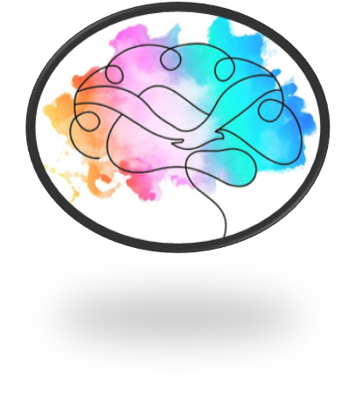
Co-Morbidity in ID/DD Populations
Common triggers for the onset of the MH symptoms
  Unexpected or quick changes in environment, residence, or caregiver
  Bullying or pattern of peer rejection (bullied 1.5-2x more than non-ID peer)
  Environmental stressors (nearly 64% of parents divorce)
  Abuse or Neglect/Witness Domestic Violence/Traumatic Event
    83% chance to experience 2 or more ACEs (Adverse Childhood Experiences)
    4x more likely to witness DV
  Genetic Predisposition or Neurological
  Untreated or unrecognized medical condition
Constantino 2020, Seigel & McGuire 2020, Munir 2016
Notes:
Reaction to change may be greater than expected.

Slide 10
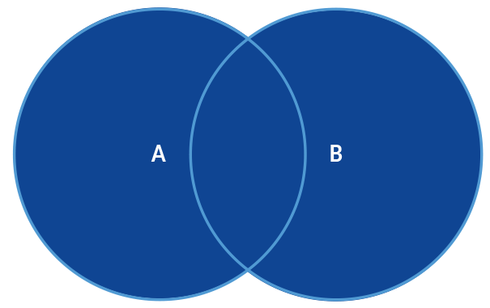
Common Problem Behaviors in the Developmental Disability Population
Self-Injurious Behaviors (SIB) (e.g., biting self, hitting self)
Stereotyped Movement (e.g., rocking, flapping)
Pica (i.e., eating of non-food)
Reaction-based aggression
Reduced attention

Slide 11
Autism Spectrum Disorder (ASD)
The Autism and Developmental Disabilities Monitoring Network (ADDM) released in April 2025 indicated that 39.6% of the autistic children also met the criteria for an intellectual disability.
ASD more common with higher levels of severity of intellectual disability.
Diagnosis of ASD and ID are associated with higher levels of other conditions such as ADHD, anxiety, and depression.
Thurm 2019, Brugha 2016, ADDM 2025
Notes:
1 in 31
Pronoun confusion less likely in milder. You/I more indicative of ASD, while she/he of either
Inappropriate social comments for ID more about naivety vs impairment in social norms
Common medical conditions:
Seizures (25%)
Sleep disorders (44-83%)
Feeding problems (70-90%)
Gastrointestinal issues (23-42%).
Mood (anger, bipolar, depression)- not as clear figures. 2011 KKI data for ASD pop: Depression-15.7% of 9-12 yo, 27.6% of 13-18 yo. Bipolar 6.9% for 9-12 yo & 10.4 for 13-18 yo. (NIMH data of general population of 13-18yo: any mood 14%, depression 11%, 0-3% for bipolar with recent 2012 NIMH study = 2.5% )
Common mental health conditions: ADHD (40-50% vs. <10% of general population), Anxiety (40% vs. 15% gen pop), Mood disorders (10% bipolar vs. <3% gen pop), Elopement (48%)

Slide 12


Autism Spectrum Disorder (ASD)
Deficit (ASD) vs Delays (ID/DD):
Social skills
Understanding of friendships
Complex gestures
Pretend play
Symptom may overlap ASD and ID/DD:
Stereotyped movement
Pronoun confusion
Sensory issues
Interest in part of an object
Inappropriate social comments
Lower imitation skills
ASD symptoms less common in ID:
Limits in eye contact
Lower interest in peers
Lower shared enjoyment
Reduced pointing or joint attention skills
Scripted speech or echolalia
Intense, narrowed interests
Unusual preoccupations
Ritualistic behavior
Fixation/Rigidity
Thurm 2019, Brugha 2016, ADDM 2025
Notes:
Pronoun confusion less likely in milder. You/I more indicative of ASD, while she/he of either
Inappropriate social comments for ID more about naivety vs impairment in social norms

Slide 13

Attention-Deficit/Hyperactivity Disorder (ADHD)
Thirty percent of individuals with ID also met the criteria for ADHD. Onset of ADHD is similar to typically developing peers.
Associated more with just ADHD:
Hyperactivity
Impulsivity
Distractible
Symptoms overlap ADHD and ID:
Forgetful
Lower attention to details
Organizing skills
Planning skills
Both have social immaturity, but ID is more significant
Buckley 2020, Platt 2019

Slide 14
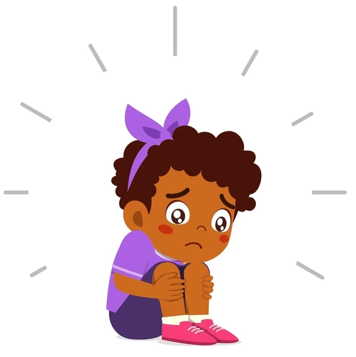
Anxiety Disorders
Common associated symptom with ID/DD
Estimated to occur in 7-34% of the ID/DD population
Can have bigger fear reaction than TD population
Worry may not be obvious due to lower communication
Certain genetic conditions can be much higher in co-morbid diagnosis of anxiety such as Williams syndrome or Fragile X syndrome
Generalized anxiety and phobia seemed to occur at higher percentage
Separation anxiety can take longer to resolve with ID/DD
Distinguishing between anxiety and intellectual disability is more about examining the anxiety along a continuum.
Buckley 2020, Emerson 2007

Slide 15
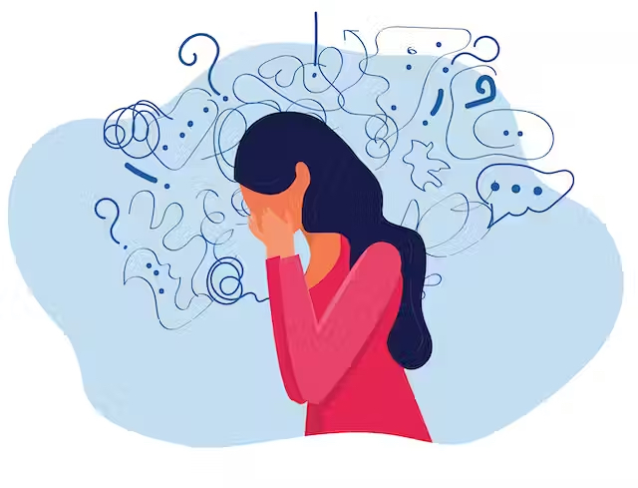
Mood Disorders
Individuals with ID/DD have at least as likely if not higher chance of Depression occurs between 2.2-15.8%.
Approximately 2.3% of ID/DD population develop bipolar compared to 1% of the general population
Presentation can be sometimes be atypical with increased emotional dysregulation or irritability
Emotional responses may be how the person communicates feeling depressed
In regard to decreased need for sleep with mania, it can be less obvious due to pre-existing sleep difficulties. Increased sleep and fatigue with depression easier to identify.
Hsieh 2021, Cooper 2020

Slide 16
Psychotic Disorders/ Schizophrenia
Approximately 2.7-4.4% of the ID/D population meets the criteria for schizophrenia compared .3 to .7% of the general population.
Things to Consider:
  Individuals with developmental disabilities may externalize self-talk more. This does not suggest a sign of psychosis.
  May struggle to differentiate between “internal voice” vs hallucinations.
  Difference between loss of reality and fantasy play.
Cooper 2007, Hesapcioglu 2021

Slide 17

What To Do Next?
Seek diagnostic clarification and evaluation from psychologist or psychiatrist (or developmental pediatrician if younger) who are familiar with neurodevelopmental disabilities.
Restore environmental supports previously working (e.g., level of caregivers, accommodations, style of approach of caregiver, stability of routine).

Slide 18

What To Do Next?
Treat “as-if” the individual has the diagnosis in the meantime if team agrees.
    For example, if treatment team suspect autism as well, consider using similar approaches such as visual supports and social stories to help with transitions, social coaching, and situational expectations.
If seems closer to common “problem behaviors” rather than another diagnosis, consider severity, how often (frequency), and how long last (duration).
    Use common strategies if milder severity or occasional frequency such as functional communication training, antecedent-based approaches, or positive behavior supports
    Consider seeking more intensive intervention if moderate or higher severity or regularly occurring behavior that interferes with functioning such as behavior management, therapy, or medication consultation.

Slide 19

Questions?
Thank you
Jennifer Sheehy-Knight, PhD
Alabama Developmental and Behavioral Specialists
100 Concourse Parkway, Suite 303
Hoover, AL 35244
205-530-1235
www.alabamadbs.com

